Slide 1
KV4000
Week 8
Text User Interfaces
The main method

Slide 2
User Interface and Model
Model:
the business (entity) classes & objects that solve the problem at hand.
User interface:
boundary class(es)
interacts with user
getting input from user
giving output to user
reporting on status of model.
Flexibility in design:
identifying these as separate subsystems.

Slide 3
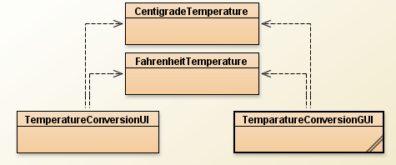
Why split into UI and model?
Can use alternative UI’s without changing model.
Allows multiple clients.
Application Boundary

Slide 4
Building a simple Text based UI
A Fahrenheit to Centigrade Conversion Application.
The Specification:
Allow user to input temperature in Fahrenheit and be told the Centigrade equivalent.
Allow user to do opposite, i.e. Centigrade to Fahrenheit.
Allow user to quit.
Program menu driven.

Slide 5
Design Thoughts
Need to identify classes
a Fahrenheit class?
a Centigrade class?
both?
How to deal with I/O?

Slide 6
FahrenheitTemperature Class
What services should this class provide?
no-arg constructor : what initial value?
get Temperature
set Temperature
get Centigrade equivalent

Slide 7
CentigradeTemperature Class
What services should this class provide?
no-arg constructor : what initial value?
get Temperature
set Temperature
get Fahrenheit equivalent

Slide 8
FahrenheitTemperature Class
public class FahrenheitTemperature
{
private double fTemperature; // The Fahrenheit temperature
public FahrenheitTemperature()
{
fTemperature = 32.0; // freezing point of water
}

Slide 9
FahrenheitTemperature Class
public double getFTemperature()
{
// simple accessor
}
public double convertToCentigrade()
{
double centigrade;
centigrade = 5.0 * (fTemperature -32.0) / 9.0;
return centigrade;
}
public void setFTemperature( double newFTemperature)
{
// simple mutator
}

Slide 10
CentigradeTemperature class
Essentially similar to FahrenheitTemperature class.
Main difference in conversion formula:
fahrenheit = 9.0 * cTemparature / 5.0 + 32.0
Coding left as an exercise – over to you.

Slide 11
Exercise 1
Create a new project called TemperatureConversion.
Add the FahrenheitTemperature class.
Add the CentigradeTemperature class.
Test both classes.

Slide 12
Text UI Class
Will provide a menu with commands to:
Convert from F to C
Convert from C to F
Quit the program
What does the UI need to know?
FahrenheitTemperature object
CentigradeTemperature object
Any thing else?

Slide 13
Text UI Code
public class TemperatureConversionUI
{
// attributes
private CentigradeTemperature c ;
private FahrenheitTemperature f ;
private Scanner myScanner;
// constructor
// methods
} // end class

Slide 14
constructor
public TemperatureConversionUI()
{
c = new CentigradeTemperature();
f = new FahrenheitTemperature ();
myScanner = new Scanner(System.in);
}

Slide 15
Exercise 2
Create the class TemperatureConversionUI.
Add the declaration of attributes and the constructor to the class.
Compile and test it.

Slide 16
Some thoughts on the menu
Consider what it should look like

Slide 17
What should a menu method do
Need to display instructions
lots of System.out.println statements
Need to get and store the command
user needs to input a value
program needs to assign it to a suitable variable
Need to arrange for the right command to be executed.

Slide 18
First attempt at Menu
public void menu()
{
int command;
displayMenu();
command = getCommand();
execute( command );
}
Can we add this method
& compile the class?

Slide 19
displayMenu
Just outputs instructions
Add this method to the class, compile and test
private void displayMenu()
{
System.out.println( “Options are” );
System.out.println(“ Convert from Fahrenheit to Centigrade enter 1”);
System.out.println(“ Convert from Centigrade to Fahrenheit enter 2”);
System.out.println(“ To end program enter 3”);
}
Enter command: ?
private helper method
- not needed in class documentation
- implementation detail - not part of user interface

Slide 20
getCommand()
Asks for command to be entered.
Gets value using Scanner method.
private int getCommand()
{
System.out.print (“Enter command: “);
int command = myScanner.nextInt();
myScanner.nextLine(); // handle eol
return command;
}

Slide 21
execute(int command)
Select what to do based on the chosen command using if statements.
private void execute( int command)
{
if ( command == 1)
doFToC();
else
if ( command == 2 )
doCToF();
else
if ( command == 3)
System.exit(0);
else
System.out.println(“Unknown command”);
}
As this method calls 2 others that don’t exist yet (doFToC() & doCToF()), we need to create empty versions first.
e.g.
private void doFToC()
{
}
Add empty methods doFToC() & doCToF() to the class.
Add this method to the class, compile and test.

Slide 22
doFToC()
add code to method
private void doFToC()
{
System.out.print(“Enter F temperature: “);
double ft = myScanner.nextDouble();
f. setFTemperature( ft);
System.out.println( ft + “F equals “ +
f. convertToCentigrade() + “C”);
}

Slide 23
doCToF()
add code to method.
Compile and test
private void doCToF()
{
System.out.print(“Enter C temperature: “);
double ct = myScanner.nextDouble();
c. setCTemperature( ct);
System.out.println( ct + “C equals “ +
c. convertToFahrenheit() + “F”);
}

Slide 24
Exercise 3
What is still missing?
Add menu()
Test the user interface
Create an object
Call menu()
?

Slide 25
Review the design
public void menu()
{
int command;
displayMenu();
command = getCommand();
execute( command );
}
Only allows for one command then program closes

Slide 26
Better method
public void menu()
{
int command = -1;
while ( command ! = 0 )
{
displayMenu();
command = getCommand();
execute( command );
}
}
Exit command now 0
– why?

Slide 27
Java Applications
public static void main (String [ ] args)

Slide 28
Java applications
To run a Java program the JVM needs to know which class / method to start with.
It needs a class containing a method called main
There should only be one such class
Syntax:
public static void main (String [ ] args)

Slide 29
Example
public class ExampleMain
{
public static void main (String [ ] args)
{
// code goes here
}
}

Slide 30
The main method
“main” must exist.
“main” must be public.
“main” must be static (class method).
“main” must have a String array parameter.
Only “main” can be invoked.
Notes:
Explain “main”.

Slide 31
Use of main
Good OOP style requires that main be kept simple.
Guidelines:
create an object
call the first method
Should NOT be full of complex logic!

Slide 32
Exercise 4
Add the following class to your temperature conversion project
public class TemparatureMain
{
public static void main(String[] args)
{
TemperatureConversionUI textUI =
new TemperatureConversionUI()
textUI.menu();
}
}

Slide 33
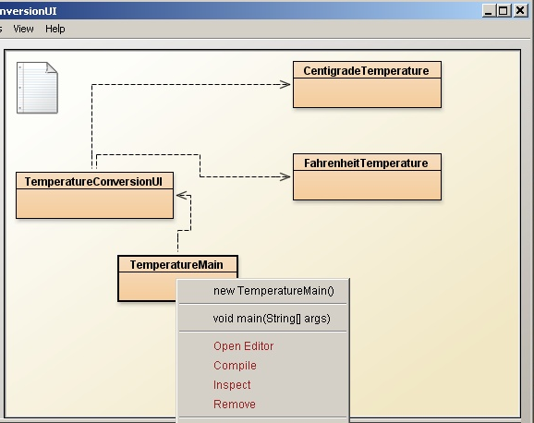
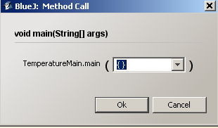
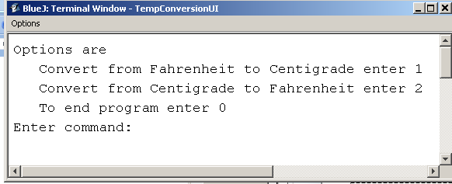
Using main in BlueJ continued
Select the class
you will see the constructor listed (ignore)
also main will be listed
You can invoke main without instantiating an object.

Slide 34
Summary
A Java application will consist of several classes.
One and only one class will contain the main method.
The main method will just start the application going.
The main method will NOT contain any complex logic.

Slide 35
Rectangle case study
On Blackboard you will find a slightly revised version of the Rectangle class used in week one.
Create a new project and add the (amended) Rectangle class.
Have a look at the code & understand its functionality.
We will now produce a user interface for the class.

Slide 36
UI Responsibilities
To get a feel lets look at the required output:
Rectangle length (a non-negative integer): 12
Rectangle breadth (a non-negative integer): 13
Enter number denoting action to perform:
Display length...................... [1]
Display breadth................... [2]
Display area........................ [3]
Display perimeter............... [4]
Create new rectangle......... [5]
Exit...................................... [0]
Enter command:
Creating a rectangle
Main operation

Slide 37
Exercise 5
On Blackboard you should find a file TextUITemplate.java.
Copy it into your project.
Rename it RectangleTUI.java
If you look in this class you will see it contains all the code that is common for text based menu style user interfaces.
Add a Rectangle attribute called rectangle and set it to null in the constructor.
rectangle = null;

Slide 38
Exercise 6
Complete the displayMenu method so that when invoked it outputs:
Enter number denoting action to perform:
Display length....................[1]
Display breadth..................[2]
Display area........................[3]
Display perimeter...............[4]
Create new rectangle.........[5]
Exit......................................[0]

Slide 39
Exercise 6 Solution: displayMenu
private void displayMenu()
{
System.out.println();
System.out.println("Enter number denoting action to perform:");
System.out.println("Display length....................[1]");
System.out.println("Display breadth..................[2]");
System.out.println("Display area.......................[3]");
System.out.println("Display perimeter...............[4]");
System.out.println("Create new rectangle.........[5]");
System.out.println("Exit.....................................[0]");
}

Slide 40
Modifying the menu method
When the program starts we want to display the following two lines:
Rectangle length (a non-negative integer):
Rectangle breadth (a non-negative integer):
This need to be done before we enter the main menu loop.
For now add an ‘empty’ method createRectangle() that will deal with Rectangle creation.
Add a call to this method at the beginning of the menu method.
private void createRectangle()
{
}

Slide 41
The code for menu
public void menu()
{
createRectangle () ;
int command = -1;
while ( command != 0 )
{
displayMenu();
command = getCommand();
execute( command );
}
}

Slide 42
readIntWithPrompt (String prompt)
Because the action of prompting to read an int is used several times we’ve put the code in a single method.
Easier to manage
Add to the class
private int readIntWithPrompt(String prompt)
{
System.out.print(prompt);
int input = keyboard.nextInt();
keyboard.nextLine();
return input;
}
Make sure nothing left on line

Slide 43
createRectangle ()
private void createRectangle ()
{
int length;
int breath;
length
= readIntWithPrompt("Rectangle length (a non-negative integer): ");
breadth
= readIntWithPrompt("Rectangle breadth (a non-negative integer): ");
rectangle = new Rectangle(length, breadth);
}

Slide 44
Exercise 7
Complete the createRectangle() method.
Add the private methods that execute the actions.
Add the code needed to complete the execute method.
Build the code a little at a time.
Test the class after each method has been added.

Slide 45
some of the code
private void execute( int command)
{
if ( command == 1)
displayLength();
else if ( command == 2 )
displayBreadth();
else if ( command == 3)
displayArea();
else if ( command == 4 )
displayPerimeter();
else if ( command == 5)
createRectangle() ;
else if ( command == 0)
{
System.out.println( " Program closing down");
System.exit(0);
}
else
System.out.println("Unknown command");
}

Slide 46
Some more of the code
private void displayLength() {
System.out.println( "The length is " + rectangle.getLength() );
}
private void displayBreadth() {
System.out.println( "The breadth is " + rectangle.getBreadth() );
}
private void displayArea() {
System.out.println( "The area is " + rectangle.calculateArea() );
}
private void displayPerimeter() {
System.out.println( "The perimeter is " + rectangle.calculatePerimeter() );
}

Slide 47
The driver
public class RectangleDriver
{
public static void main (String[] args)
{
RectangleTUI rec = new RectangleTUI();
rec.menu();
}
}
Keep the driver simple

Slide 48
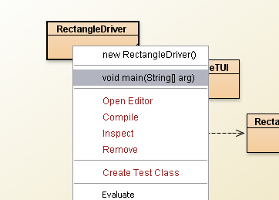
Exercise 8
Add the driver class to your project.
Compile.
Select the Driver class and invoke main.

Slide 49
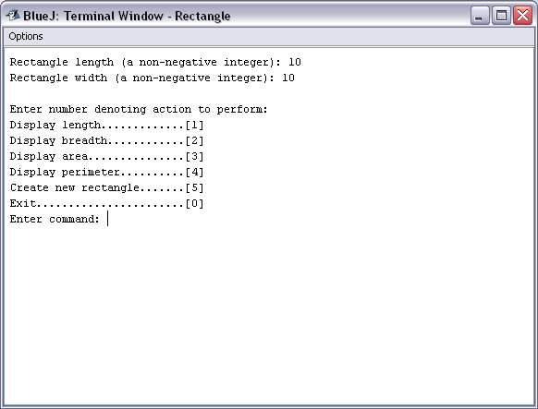
The terminal window

